Slide 1
So what’s the big deal about scarcity?

Slide 3
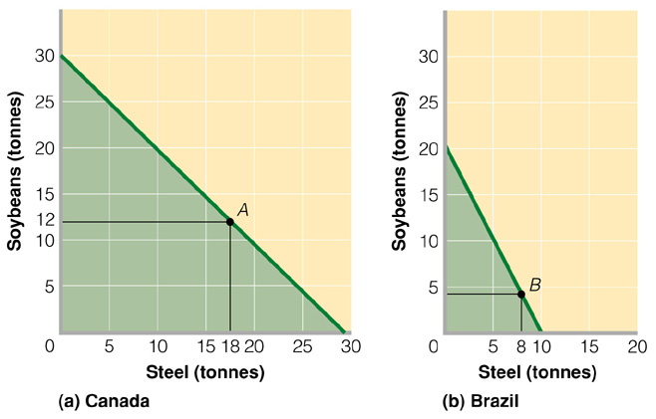
The Production Possibility Frontier
http://members.shaw.ca/elementaleconomics/mac_5_1.htm

Slide 4
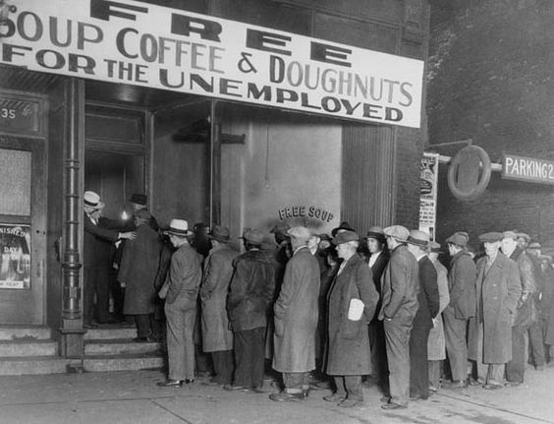
The Great Depression

Slide 6
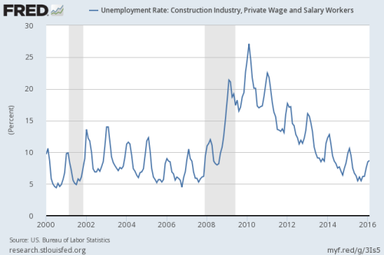

Slide 7
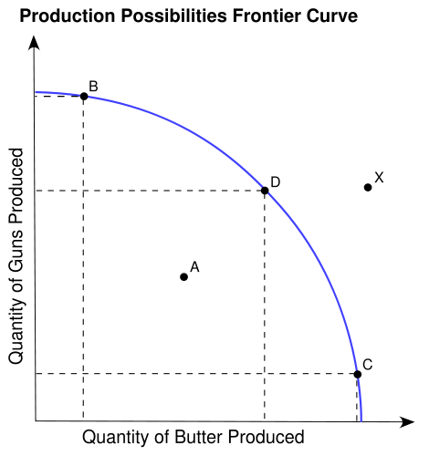
Why is the Production Possibility Curve curved?

Slide 8
Globalization

Slide 9
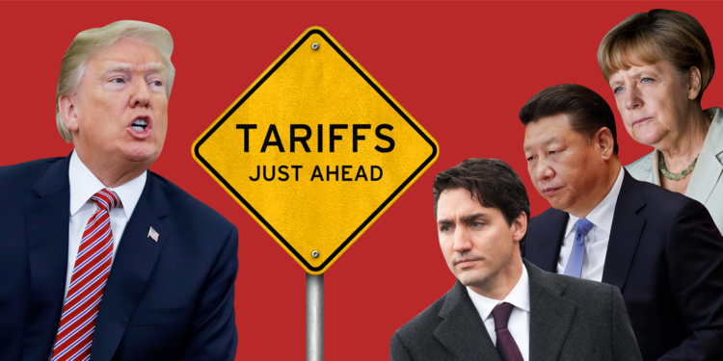

Slide 10
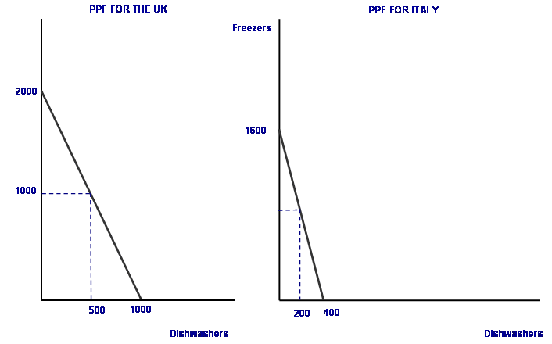
Why Trade? Comparative Advantage

